Slide 1
A Reactive Strategy for
High-Level Consistency During Search
R.J. Woodward^{1,2} B.Y. Choueiry¹ Christian Bessiere²
¹Constraint Systems Laboratory, University of Nebraska-Lincoln
²CNRS, University of Montpellier
Acknowledgements
Experiments conducted at UNL’s Holland Computing Center
NSF Grant RI-111795, RI-1619344
NSF GRF and Chateaubriand Fellowship
ANR Demograph (ANR-16-CE40-0028) and Contredo (ANR-16-CE33-024)

Slide 2
Context
Solving a Constraint Satisfaction Problem (CSP)
  Conditioning: Backtrack search
  Inference: Enforcing consistency
    Consistency properties (e.g., GAC)
    Constraint propagation algorithms
Consistency during search
  Constraint Programming solvers: GAC or weaker
  CSP research: GAC or stronger
Our focus: Higher-level consistency (HLC)
Notes:
By running/executing a consistency algorithm. GAC is one such standard consistency property.
Constraint programming solvers enforce GAC or weaker properties, whereas in CSP research we enforce GAC or stronger properties. … Higher-level consistencies are strictly stronger than GAC.

Slide 3
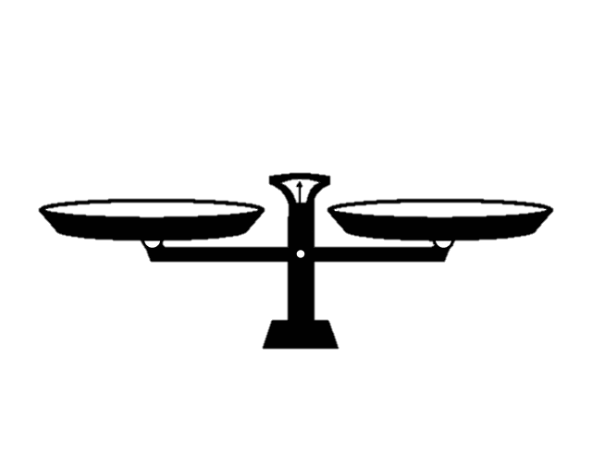
Lesson and Problem
Maintaining consistency during search
  Enforced at each variable instantiation
  Prunes subtrees, reduces search space
Stronger consistency
  Filters more subtrees
  But is costlier to enforce
1
HLC
GAC
Cost of
Consistency
Cost of
Search
n
GAC vs HLC
Notes:
HLC = operates on more than one constraint at a time. GAC does one.

Slide 4
Challenge
Decide when, where, and how much HLC to enforce during search
How much?
When?
Always HLC
Always GAC
Where?
Where?
Entire CSP
One variable
How much?
Until fixpoint
Stop early
HLC
When?

Slide 5
Our solution
When: PrePeak
  Monitors search performance
  When search starts thrashing, triggers an HLC
  Then, conservatively reverts to GAC
How much
  Monitor propagation and interrupt before fixpoint
How much?
Where?
HLC
When?
PrePeak⁺ = PrePeak + ‘How Much’

Slide 6
PrePeak examines #BT per depth
Trigger HLC when #BT reaches a threshold θ
HLC
θ
If HLC yields
  Wipeout (highly effective), reduce θ
  Some filtering, increase θ a little
  No filtering (HLC is wasteful), increase θ a lot
In the last 2 cases, reset #BT per depth to 0
Thus, return to GAC
1
Peak
HLC
GAC
275

Slide 7
Empirical Evaluations
Using dom/deg

Slide 8
Thank You
Goal state
Posters
Demo
booths
Coffee
Exhibition
Possible
start states
Coffee
Coffee

Slide 9
Thank You
Questions & Comments
Please stop by the poster #51

Slide 10
Visualization of Benefit
pseudo-aim-200-1-6-4, dom/wdeg

Slide 11
Visualization of Benefit
pseudo-aim-200-1-6-4, dom/wdeg

Slide 12
Visualization of Benefit

Slide 13
PrePeak A Reactive Strategy for HLC
Keep track of btcount[⋅], number of backtrack during search
When btcount[⋅] reaches a given threshold θ
  Enforce GAC then HLC as long as HLC yields
  domain wipeout for all values in domain of current variable
  If backtrack, reduce threshold and keep enforcing HLC
  If HLC finds a consistent value, reset btcount[⋅], increase threshold a little
  If GAC finds a consistent value, reset btcount[⋅], increase threshold a lot
Geometric laws to update threshold
  Wipeout:
  Filtering:
  No filtering:
1
275
Notes:
\theta^{bt}_{k+1} \gets r_w \theta_k^{bt}
\theta^{bt}_{k+1} \gets r_w\cdot\theta_k^{bt}, r_w = 1.2^{-1}\\
\theta^{bt}_{k+1} \gets r_f\cdot\theta_k^{bt}, r_f = 1.2^{2}\\
\theta^{bt}_{k+1} \gets r_n\cdot\theta_k^{bt}, r_n = 1.2^{3}\\

