Slide 1


Improving Relational Consistency Algorithms Using Dynamic Relation Partitioning
Anthony Schneider¹ Robert J. Woodward^{1,2}
Berthe Y. Choueiry¹ & Christian Bessiere²
¹Constraint Systems Laboratory, University of Nebraska-Lincoln
²LIRMM, CNRS & University of Montpellier II
Acknowledgements
Experiments conducted at UNL’s Holland Computing Center
Woodward supported by a NSF Graduate Research Fellowship grant number 1041000
NSF Grant No. RI-111795 and EU project ICON (FP7-284715)

Slide 2
Outline
Introduction
  R(∗,m)C property and its algorithm PerTuple
Partitioning a relation
  Coarse, fine, intermediate blocks
Improve PerTuple using partitions
  PerTuple → PerFB
Experimental results
Conclusion

Slide 3
R(∗,m)C (a.k.a. m-wise consistency)
A CSP is R(∗,m)C iff
  Every tuple in a relation can be extended
  to the variables in the scope of any (m-1) other relations
  in an assignment satisfying all m relations simultaneously
R(∗,m)C ≡ Every set of m relations is minimal
∀ tuple
..…
∀ relation
∀ m-1 relations

Slide 4
PerTuple
[Karakashian+ AAAI 10]
PerTuple enforces R(∗,m)C
Store all connected combinations of m relations
Update propagation queue
For each relation in a combination
  For each tuple in the relation
  SearchSupport: Conduct backtrack search with FC over the dual CSP induced by the m relations
  Remove the tuple if no solution is found
t_{i}
t₃
t₂
t₁

Slide 5
Piecewise Functional Constraints
PW-AC enforces R(∗,2)C [Samaras & Stergiou JAIR 05]
R₁
R₂
R₁
 | A | B | C | D | G
t₁ | 0 | 0 | 0 | 0 | 0
t₂ | 0 | 0 | 0 | 1 | 0
t₃ | 0 | 0 | 1 | 0 | 0
t₄ | 0 | 0 | 1 | 1 | 1
t₅ | 0 | 1 | 1 | 0 | 1
t₆ | 0 | 1 | 1 | 1 | 1
t₇ | 1 | 1 | 1 | 1 | 1
A | B | E
0 | 0 | 0
0 | 0 | 1
0 | 1 | 0
0 | 1 | 1
1 | 0 | 0
1 | 0 | 1
A,B,C,D,G
A,B
A,B,E
A,B,F
B,E,G
C,F
R₂
✗
✗
Notes:
Samaras and Stergiou found that the constraints in a dual CSP are piecewise functional.
What does that mean?
If you look at a CSP like the one here, the constraints are binary and enforce equality on their shared variables, which we call the subscope.
Because the constraint is piecewise functional, we can partition R1 and R2 into blocks of equivalent tuples where the values for AB are the same. Each block in R1 is supported by at most one block in R2 because the constraint is PWF. Notice that the block of pink tuples does not have a support and can thus be removed. This is the basis of the PW-AC alg orithm of S&S.

Slide 6
Types of Partitions
R₁: coarse blocks
R₁: fine blocks
R₁: intermediate
R₁
t₁
t₂
t₃
t₄
t₅
t₆
t₇
C₂
o₁
cb₁ | t₁
 | t₂
 | t₃
 | t₄
cb₂ | t₅
 | t₆
cb₃ | t₇
o₂
cb₄ | t₁
 | t₂
 | t₃
cb₅ | t₄
cb₆ | t₅
 | t₆
 | t₇
o₃
cb₇ | t₁
 | t₂
cb₈ | t₃
 | t₄
 | t₅
 | t₆
 | t₇
o₁∪o₂∪o₃
fb₁ | t₁
 | t₂
fb₂ | t₃
fb₃ | t₄
fb₄ | t₅
 | t₆
fb₅ | t₇
o₁∪o₃
ib₁ | t₁
 | t₂
ib₂ | t₃
 | t₄
ib₃ | t₅
 | t₆
ib₄ | t₇
o₁
o₁
C₃
C₁
o₂
C₄
o₃
C₅
For each relation, we store
  A single partition of fine blocks
  As many partitions of coarse blocks as shared subscopes
Notes:
We noticed that there are several types of partitions for a given constraint, depending on which portion of its neighborhood in the dual graph you consider.
So for, the constraint C1, if you look at each of its neighbors independently, there are 3 partitions. These are types of partitions identified by S&S, and are the coarsest possible partitions of the relation R1
Now if we look at the entire neighborhood of the constraint C1, we obtain the finest partition of the relation. Finally, if we consider a subset of a constraints neighborhood…These intermediate scopes are important, and are used when looking at combinations of relations when enforcing relational consistency.

Slide 7
PerTuple → PerFB
Tuple → Fine Block (FB)
General mechanism is identical
  Combinations, queuing, and propagation
SearchSupport
  Search enumerates fine blocks, not tuples
  Forward checking operates on coarse blocks
Calls to SearchSupport reduced
  Skips tuples in the same fine blocks
  Skips fine blocks in the same intermediate block
  Using two local data structures
Details in paper
…

Slide 8
Enforcing R(∗,m)C with PerFB
Vars in subscopes
R₁
R₂
R₅
 |  | A | B | C | D | G
fb₁ | t₁ | 0 | 0 | 0 | 0 | 0
 | t₂ | 0 | 0 | 0 | 1 | 0
fb₂ | t₃ | 0 | 0 | 1 | 0 | 0
fb₃ | t₄ | 0 | 0 | 1 | 1 | 1
fb₄ | t₅ | 0 | 1 | 1 | 0 | 1
 | t₅ | 0 | 1 | 1 | 1 | 1
fb₅ | t₇ | 1 | 1 | 1 | 1 | 1
 | A | B | E
fb₆ | 0 | 0 | 0
fb₇ | 0 | 0 | 1
fb₈ | 0 | 1 | 0
fb₉ | 0 | 1 | 1
fb₁₀ | 1 | 0 | 0
fb₁₁ | 1 | 0 | 1
 | C | F
fb₂₀ | 0 | 0
fb₂₁ | 0 | 1
fb₂₂ | 1 | 0
Rel | Variables
R₁ | ABC
v
Equiv FBs for R₁
A | B | C | Consistent
- | - | - | -
A | B | C | Consistent
0 | 0 | 0 | True

Slide 9
Enforcing R(∗,m)C with PerFB
Vars in subscopes
R₁
R₂
R₅
 |  | A | B | C | D | G
fb₁ | t₁ | 0 | 0 | 0 | 0 | 0
 | t₂ | 0 | 0 | 0 | 1 | 0
fb₂ | t₃ | 0 | 0 | 1 | 0 | 0
fb₃ | t₄ | 0 | 0 | 1 | 1 | 1
fb₄ | t₅ | 0 | 1 | 1 | 0 | 1
 | t₅ | 0 | 1 | 1 | 1 | 1
fb₅ | t₇ | 1 | 1 | 1 | 1 | 1
 | A | B | E
fb₆ | 0 | 0 | 0
fb₇ | 0 | 0 | 1
fb₈ | 0 | 1 | 0
fb₉ | 0 | 1 | 1
fb₁₀ | 1 | 0 | 0
fb₁₁ | 1 | 0 | 1
 | C | F
fb₂₀ | 0 | 0
fb₂₁ | 0 | 1
fb₂₂ | 1 | 0
Rel | Variables
R₁ | ABC
?
Equiv FBs for R₁
A | B | C | Consistent
0 | 0 | 0 | True
0 | 0 | 1 | True
A | B | C | Consistent
0 | 0 | 0 | True

Slide 10
Enforcing R(∗,m)C with PerFB
Vars in subscopes
R₁
R₂
R₅
 |  | A | B | C | D | G
fb₁ | t₁ | 0 | 0 | 0 | 0 | 0
 | t₂ | 0 | 0 | 0 | 1 | 0
fb₂ | t₃ | 0 | 0 | 1 | 0 | 0
fb₃ | t₄ | 0 | 0 | 1 | 1 | 1
fb₄ | t₅ | 0 | 1 | 1 | 0 | 1
 | t₅ | 0 | 1 | 1 | 1 | 1
fb₅ | t₇ | 1 | 1 | 1 | 1 | 1
 | A | B | E
fb₆ | 0 | 0 | 0
fb₇ | 0 | 0 | 1
fb₈ | 0 | 1 | 0
fb₉ | 0 | 1 | 1
fb₁₀ | 1 | 0 | 0
fb₁₁ | 1 | 0 | 1
 | C | F
fb₂₀ | 0 | 0
fb₂₁ | 0 | 1
fb₂₂ | 1 | 0
Rel | Variables
R₁ | ABC
Yes!
?
Equiv FBs for R₁
A | B | C | Consistent
0 | 0 | 0 | True
0 | 0 | 1 | True

Slide 11
Experimental Setup
Backtrack search, find first solution, dom/deg
m = 2, 3, 4, |𝜓(cl)|
XCSP benchmark of CP Solver Competition
Maintaining R(∗,m)C
  Use a tree-decomposition of the CSP
  Enforce consistency on individual clusters
  Add projection of constraints to separators to bolster propagation between adjacent clusters
  Use a minimal dual graph to reduce number of combinations of m constraints
  Better performance than GAC, maxRPWC
[Karakashian+ AAAI 13]
[Lecoutre+]

Slide 12
PerFB vs. PerTuple: completed instances
CPU Time (s)
Number of instances completed
Notes:
Explain title, Explain axes, colors, and say PerFB always dominates PerTuple

Slide 13
PerFB vs. PerTuple: completed instances
CPU Time (s)
Number of instances completed
Notes:
…for all of the tested combination sizes

Slide 14
PerFB m = 2,3,4, |𝜓(cl)|
m = |𝜓(cl)|
m = 4
CPU Time (s)
m = 2
m = 3
Number of instances completed
Notes:
Nxt looked at perfb for the tested combination sizes
…Are competitive, and outperform m=4 and pairwise consistency. Incidentally, this shows that higher order consistency is very competitive. And now, we can do it cheaper.

Slide 15
Detailed Results
Number of instances tested: 853
 | m = 2 |  | m = 3 |  | m = 4 |  | m = |𝜓(cl)|
 | PerTuple | PerFB | PerTuple | PerFB | PerTuple | PerFB | PerTuple | PerFB
#Completed | 546 | 557 | 604 | 616 | 566 | 589 | 597 | 615
… only by | 5 | 16 | 1 | 13 | 2 | 25 | 8 | 26
… by both | 541 |  | 603 |  | 564 |  | 589
Avg. CPU (sec) | 538 | 227 | 521 | 362 | 472 | 314 | 669 | 458
SearchSupport calls (10⁹) | 86.4 | 0.0 | 88.1 | 26.1 | 52.7 | 19.6 | 24.7 | 8.1
Call ratio | -- |  | 3.37 |  | 2.69 |  | 3.06
Notes:
Don’t need to conduct search support on m-2 because the constraint is PWF. This allows us to immediately determine if a fine block is supported in another relation.

Slide 16
Conclusions
Contributions
  Designed PerFB
    to replace PerTuple of [Karakashian+ AAAI 10]
    by extending the work of [Samaras & Stergiou JAIR 05]
  Empirically showed benefits of our approach
Future work
  Extend our approach to our other algorithm for enforcing R(∗,m)C [Karakashian PhD 13]
Notes:
… extending the work of Samaras & Stergiou *beyond* combinations of two constraints to any combination of constraints

Slide 17
Thank you for listening
Wake up the Chair!

Slide 18
CSP: Graphical Representations
Hyper graph
Dual graph
Minimal dual graph
E
R₄
R₁
R₂
D
A
B
G
C
R₃
F
R₅
Hyper graph
R₁
R₁
A,B,C,D,G
A,B,C,D,G
A,B
A,B
B,G
C
A,B
A,B
B,G
C
A,B,E
A,B,F
B
B,E,G
C,F
A,B,E
A,B,F
B
B,E,G
C,F
A,B
A,B
R₂
R₃
R₄
F
R₅
R₂
R₃
R₄
R₅
B,E
B,E
F
Dual graph
Minimal dual graph
[Janssen+,1989]
Notes:
an edge between two vertices is redundant if there exists an alternate path between the two vertices such that the shared variables appear in every vertex in the path

Slide 19
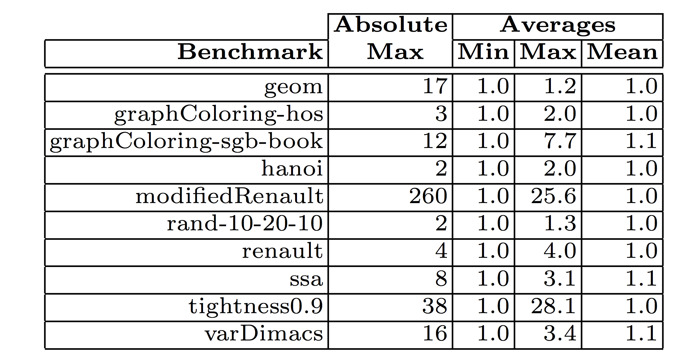
Block Statistics

Slide 20
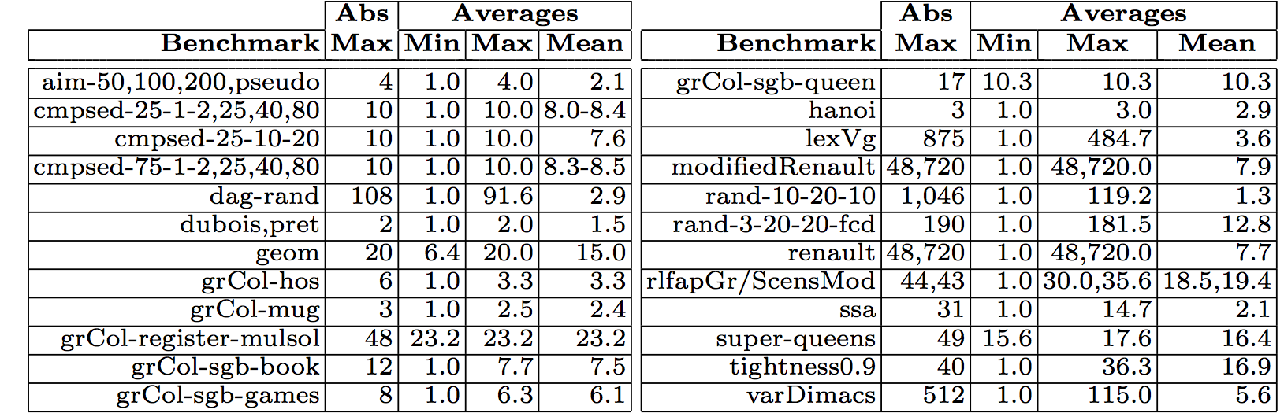
Block Statistics
Notes:
8 Gigs of ram and 2 hours per instance
Mention that benchmarks not listed in the table had min, max, and mean of 1.

Slide 21
Partitioning Relations -- Definitions
Scope
Subscope
Combination
R₁
A,B,C,D,G
A,B
A,B
B,G
C
A,B,E
A,B,F
B
B,E,G
C,F
A,B
R₂
R₃
R₄
R₅
B,E
F
Notes:
Use graph/animations here to highlight examples of these definition. Maybe merge this into another slide? (It’s a weird slide…). I’ll just explain this stuff on slides 3 and 4.

Slide 22
Coarse Partitions
R₁
R₂
R₃
 |  | A | B | C | D | G
fb₁ | t₁ | 0 | 0 | 0 | 0 | 0
 | t₂ | 0 | 0 | 0 | 1 | 0
fb₂ | t₃ | 0 | 0 | 1 | 0 | 0
fb₃ | t₄ | 0 | 0 | 1 | 1 | 1
fb₄ | t₅ | 0 | 1 | 1 | 0 | 1
 | t₅ | 0 | 1 | 1 | 1 | 1
fb₅ | t₇ | 1 | 1 | 1 | 1 | 1
 | A | B | E
fb₆ | 0 | 0 | 0
fb₇ | 0 | 0 | 1
fb₈ | 0 | 1 | 0
fb₉ | 0 | 1 | 1
fb₁₀ | 1 | 0 | 0
fb₁₁ | 1 | 0 | 1
 | A | B | F
fb₁₂ | 0 | 0 | 0
fb₁₃ | 0 | 0 | 1
fb₁₄ | 0 | 1 | 1
fb₁₅ | 1 | 1 | 0
fb₁₆ | 1 | 1 | 1
R₁
A,B,C,D,G
A,B
A,B
B,G
C
A,B,E
A,B,F
B
B,E,G
C,F
A,B
R₂
R₃
R₄
F
R₅
B,E
Notes:
Idea similar to “groups” in Samaras & Stergiou, but defined over subscopes instead of pairwise between relations
Use this to also show how these things are stored/related (Fig 7)? Probably just skip this (implementation detail)…
For a given tuple, using data structures described in the paper, it’s possible to find all of the supporting tuples in a neibhboring relation in constant time due to the PW functionality of relations in the dual
- The # of subscopes in a graph tends to be a fair amount less than the number of edges

Slide 23
Fine Partitions
Equivalence class that induces smallest set of tuples
R₁
R₂
 |  | A | B | C | D | G
fb₁ | t₁ | 0 | 0 | 0 | 0 | 0
 | t₂ | 0 | 0 | 0 | 1 | 0
fb₂ | t₃ | 0 | 0 | 1 | 0 | 0
fb₃ | t₄ | 0 | 0 | 1 | 1 | 1
fb₄ | t₅ | 0 | 1 | 1 | 0 | 1
 | t₅ | 0 | 1 | 1 | 1 | 1
fb₅ | t₇ | 1 | 1 | 1 | 1 | 1
 | A | B | E
fb₆ | 0 | 0 | 0
fb₇ | 0 | 0 | 1
fb₈ | 0 | 1 | 0
fb₉ | 0 | 1 | 1
fb₁₀ | 1 | 0 | 0
fb₁₁ | 1 | 0 | 1
R₁
A,B,C,D,G
A,B
A,B
B,G
C
A,B,E
A,B,F
B
B,E,G
C,F
A,B
R₂
R₃
R₄
F
R₅
B,E
Notes:
Highlight values in t1 and t2 in R1 that cause those to be equivalent ( ABCG, D is irrelevant to the rest of the problem since it’s only constrained by R1). This should give an intuition about how these are formed.
Each relation is finely partitioned according to all of its neighbors in the dual graph, use the union of subscopes (highlight the edges and show the union ABCG)
Mention that when the size of the union of subscopes is the same as the size of the scope, all the fine blocks will contain exactly one tuple
What ahppens when we consider all of the relations in the dual graph

Slide 24
Intermediate Partitions
Consider a combination of size m=3 …
R₁
R₁
 |  | A | B | C | D | G
fb₁ | t₁ | 0 | 0 | 0 | 0 | 0
 | t₂ | 0 | 0 | 0 | 1 | 0
fb₂ | t₃ | 0 | 0 | 1 | 0 | 0
fb₃ | t₄ | 0 | 0 | 1 | 1 | 1
fb₄ | t₅ | 0 | 1 | 1 | 0 | 1
 | t₅ | 0 | 1 | 1 | 1 | 1
fb₅ | t₇ | 1 | 1 | 1 | 1 | 1
R₂
R₅
 | A | B | E
fb₆ | 0 | 0 | 0
fb₇ | 0 | 0 | 1
fb₈ | 0 | 1 | 0
fb₉ | 0 | 1 | 1
fb₁₀ | 1 | 0 | 0
fb₁₁ | 1 | 0 | 1
 | C | F
fb₂₀ | 0 | 0
fb₂₁ | 0 | 1
fb₂₂ | 1 | 0
A,B,C,D,G
A,B
A,B
B,G
C
A,B,E
A,B,F
B
B,E,G
C,F
A,B
R₂
R₃
R₄
F
R₅
B,E
Notes:
Idea here will be to demonstrate the principle of intermediate partitions on a combination of size 3, and how multiple fine blocks can be equivalent with respect to a subgraph induced on the dual graph. Use the graph to highlight the combination/subgraph used, and the tables to show that for this specific combination, both fb2 and fb3 in R1 would be equivalent to one another.
- Cahnge this to R5 (grrr)

Slide 25
Intermediate Partitions
First, identify the subscopes that affect R₁
R₁
R₂
R₅
 |  | A | B | C | D | G
fb₁ | t₁ | 0 | 0 | 0 | 0 | 0
 | t₂ | 0 | 0 | 0 | 1 | 0
fb₂ | t₃ | 0 | 0 | 1 | 0 | 0
fb₃ | t₄ | 0 | 0 | 1 | 1 | 1
fb₄ | t₅ | 0 | 1 | 1 | 0 | 1
 | t₅ | 0 | 1 | 1 | 1 | 1
fb₅ | t₇ | 1 | 1 | 1 | 1 | 1
 | A | B | E
fb₆ | 0 | 0 | 0
fb₇ | 0 | 0 | 1
fb₈ | 0 | 1 | 0
fb₉ | 0 | 1 | 1
fb₁₀ | 1 | 0 | 0
fb₁₁ | 1 | 0 | 1
 | C | F
fb₂₀ | 0 | 0
fb₂₁ | 0 | 1
fb₂₂ | 1 | 0
Notes:
- Mention finding the fine block’s “signature”, that is, the projection of the union of subscopes in the combination onto a fineblock
R2 and R5’s intermediate partitions are identical to their coarse partitions because the union of subscopes in the combination are the same as their subscopes w.r.t their neighbors
What happens when we consider only the relations in the combination of a dual graph

Slide 26
Intermediate Partitions
Project the union of those subscopes over the relation
R₁
R₂
R₅
 |  |  | A | B | C | D | G
ib₁ | fb₁ | t₁ | 0 | 0 | 0 | 0 | 0
 |  | t₂ | 0 | 0 | 0 | 1 | 0
ib₂ | fb₂ | t₃ | 0 | 0 | 1 | 0 | 0
 | fb₃ | t₄ | 0 | 0 | 1 | 1 | 1
ib₃ | fb₄ | t₅ | 0 | 1 | 1 | 0 | 1
 |  | t₅ | 0 | 1 | 1 | 1 | 1
ib₄ | fb₅ | t₇ | 1 | 1 | 1 | 1 | 1
 | A | B | E
fb₆ | 0 | 0 | 0
fb₇ | 0 | 0 | 1
fb₈ | 0 | 1 | 0
fb₉ | 0 | 1 | 1
fb₁₀ | 1 | 0 | 0
fb₁₁ | 1 | 0 | 1
 | C | F
fb₂₀ | 0 | 0
fb₂₁ | 0 | 1
fb₂₂ | 1 | 0
Notes:
- Mention finding the fine block’s “signature”, that is, the projection of the union of subscopes in the combination onto a fineblock
R2 and R5’s intermediate partitions are identical to their coarse partitions because the union of subscopes in the combination are the same as their subscopes w.r.t their neighbors
What happens when we consider only the relations in the combination of a dual graph

