Slide 1
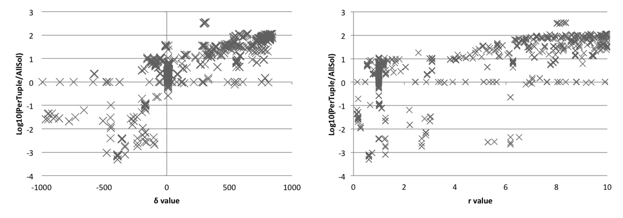
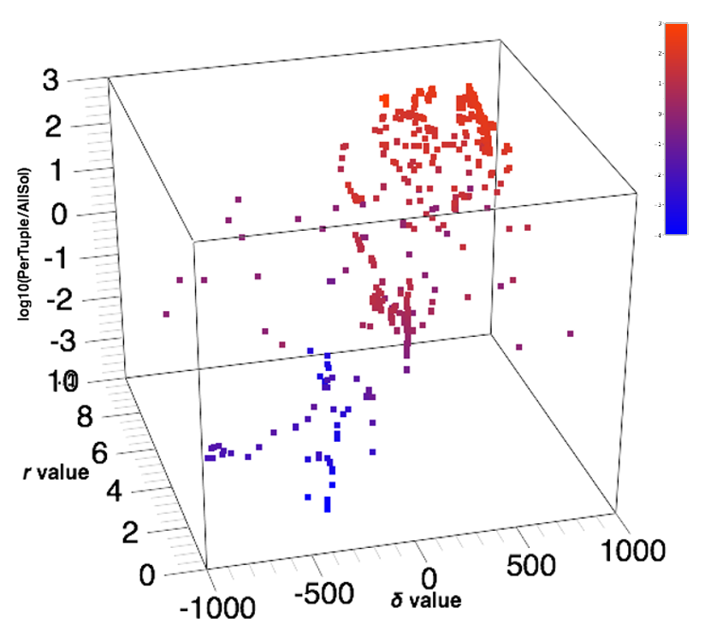


Characterizing Performance of Consistency Algorithms by Algorithm Configuration of Random CSP Generators
Daniel J. Geschwender, Robert J. Woodward, Berthe Y. Choueiry
Constraint Systems Laboratory • Department of Computer Science & Engineering • University of Nebraska-Lincoln
Constraint Satisfaction Problem:
Used to model constrained combinatorial problems
Important real-world applications: hardware & software verification, scheduling, resource allocation, etc.
B≠1
B
RBGenerator: [Xu+ AIJ 2007]
Generates hard satisfiable CSP instances at the phase transition
Final Parameter Configurations:
A
A≥B
{1,2,3,4}
k : arity of the constraints
n : number of variables
α : domain size d=n^{α}
r : # constraints m=rnln(n)
δ : distance from phase transition, p_{cr}+ δ/1000
forced : forced satisfiable?
merged : merge similar scopes?
 |  | seed | k | n | α | r | δ | forced | merged | speedup | CoV
Adjustable Size | AllSol | 4 | 2 | 20 | 1.74 | 8.28 | 309 | n | y | 348 | 5%
 | PerTuple | 2 | 2 | 17 | 0.79 | 0.61 | -394 | y | n | 4627 | 79%
Fixed Size | AllSol | 19 | 4 | 16 | 1.00 | 9.94 | 840 | y | y | 110 | 4%
 | PerTuple | 19 | 2 | 16 | 1.00 | 0.74 | -481 | n | n | 1301 | 27%
{1,2,3}
A+C<3
C
{0,1}
A CSP is defined as follows:
Given
A set of variables {A,B,C}
Their domains D_{A}={1,2,3}, D_{B}={1,2,3,4}, D_{C}={0,1}
A set of constraints: {A≥B,B≠2,A+C<3}
Question
Determine consistency NP-complete
Count number of solutions #P
Find minimal network NP-complete
Minimize number of broken constraints NP-hard
Effect of Parameters r and δ:
Sequential Model-based Algorithm Configuration:
SMAC tunes the parameter configuration of RBGenerator
RBGenerator creates CSP to run on PerTuple and AllSol
Compare runtimes and update SMAC response model
Move toward parameters which favor one algorithm over the other
Minimal Network:
Is a consistency property
Guarantees that every tuple allowed by a constraint must participate in some solution to the CSP (i.e., the constraints are as minimal as possible)
Two Algorithms for Enforcing Minimality:
AllSol: better when there are many ‘almost’ solutions
  One search explores the entire search space
  Finds all solutions without storing them, keeps tuples that appear in at least one solution
PerTuple: better when many solutions are available
  For each tuple, finds one solution where it appears
  Many searches that stop after the first solution
[Hutter+
LION 2011]
Experiments:
4 tests run, testing two factors:
  Configuring to favor PerTuple and AllSol
  With adjustable and fixed problem size parameters
Each test run over 10 configuration seeds
Configuration run for 4 days
Algorithm time limit of 20 minutes
A
(1,1) (2,1) (2,2)
(3,1) (3,2) (3,3)
B
Adjustable Problem Size:
{1,2,3}
A≥B
{1,2,3,4}
[Karakashian, PhD 2013]
Conclusions:
Configured PerTuple 1000x faster, AllSol 100x faster
PerTuple configuration: fewer constraints, lower constraint tightness
AllSol configuration: more constraints, higher constraint tightness
Adjustable problem size only offers marginally better configuration
Fixed Problem Size:
Future Work:
Compare other consistency algorithms
Use a CSP generator with more parameters
Apply results found to algorithm selection
Supported by NSF Grant No. RI-111795. Geschwender was also supported by NSF GRF Grant No. 1041000 and a Barry M. Goldwater Scholarship, and Woodward by NSF GRF Grant No. 1041000 and a Chateaubriand Fellowship. Experiments conducted at UNL’s Holland Computing Center.
AllSol
PerTuple
Date January 29, 2015

